Slide 1
The Dream Machine
My dream Machine
CPU:AMD Ryzen 9 3900X, Price $684.82 (Before Tax)
GPU:GeForce GT 1030, Price $117.99 (Before Tax)
RAM:CORSAIR Vengeance LPX, Price $106.99 (Before Tax)
Sound Card:Sound BlasterX, Price $187.57 (Before Tax)
Removable Media:LG Internal, Price $22.99 (Before Tax)
Business Computer
Notes:
To change this brochure, replace our sample content with your own. Or, if you'd rather start from a clean slate, press the New Slide button on the Home tab to insert a new page. Now enter your text and pictures in the empty placeholders. If you need more placeholders for titles, subtitles or body text, copy any of the existing placeholders, then drag the new one into place.

Slide 2
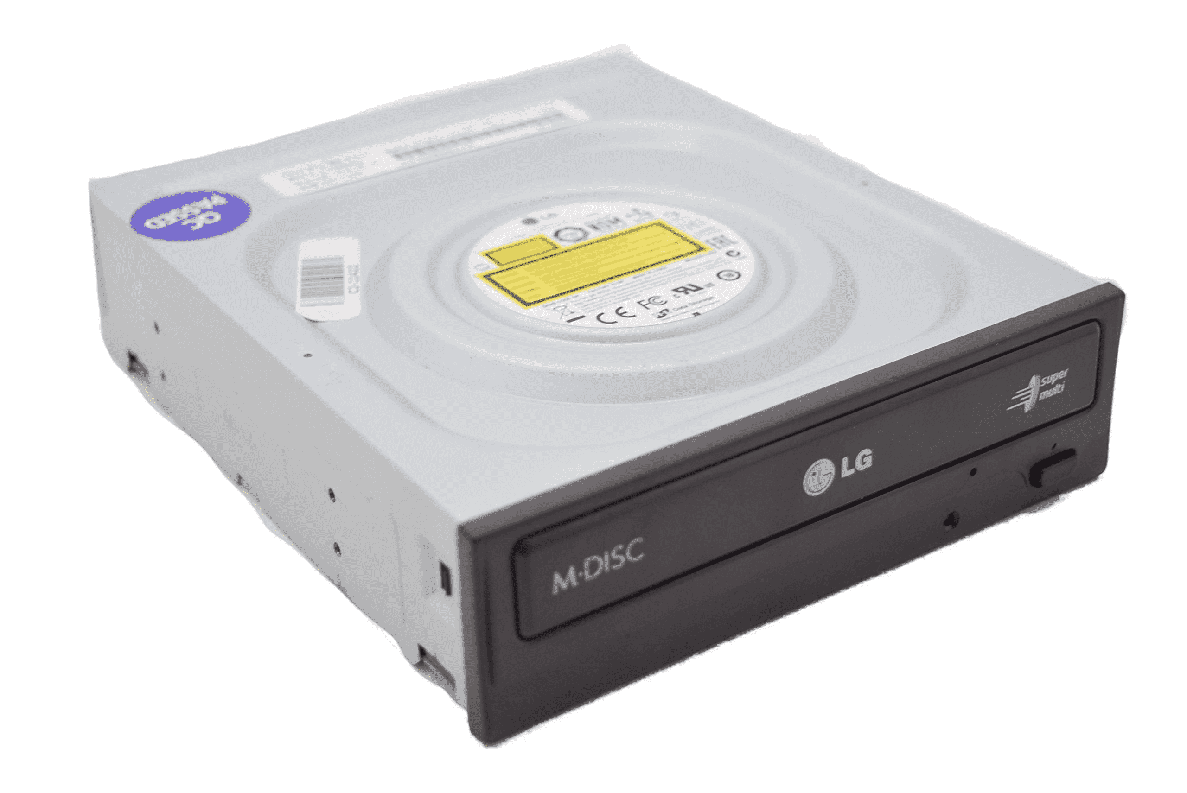
Would-Be-Nice Features
The Budget Machine
Application Topic
The application topic is businesses computer and it is meant for office jobs or stay at home jobs for some cases.
This PC has decent speed and is not that portable but because there is no graphics card or sound card it is a bit lighter than other PC, so it is portable at some degree
PC parts needed: CPU, RAM, Motherboard, HDD, Removeable Media
The three most important parts are CPU, HDD, Removable Media. CPU is important because it keeps makes the computer move smoothly and fast. HDD is important because it stores the data and files. The removeable media is important because it connects to severs in an office space.
If you want more power from the build, you can add more PC components to boost the power, but this is not needed in my opinion.
To keep the budget low I have only used the motherboards graphic card and sound card. That means there is still things that can be buffed.
The graphics card can be upgraded to a GeForce GT 1030, Price $117.99 (Before Tax).
Sound card can be upgraded to a Sound Blaster, Price $94.99 (Before Tax).
After graphics card upgrade cost $544.57 (Before Tax).
After Sound card upgrade cost $521.57 (Before Tax).
Both upgrades together cost $639.56 (Before Tax).
This budget dream is for anybody who works in jobs like accountant, real estate and other business prepuces.
The internals:
CPU: Intel Core i3-8100
RAM: CORSAIR Vengeance LPX
Motherboard/Graphic Card/Sound Card: ASUS M5A78L
HDD: Seagate BarraCuda
Removable Media: LG Internal, Internal Card Reader
The Budget for the PC is only $426.58
Notes:
To change this brochure, replace our sample content with your own. Or, if you'd rather start from a clean slate, press the New Slide button on the Home tab to insert a new page. Now enter your text and pictures in the empty placeholders. If you need more placeholders for titles, subtitles or body text, copy any of the existing placeholders, then drag the new one into place.

